Slide 1

E-commerce Data Analysis
Shriram Mantri Vidhya Nidhi Info-Tech Academy
Guided By :
Pradeep Tripathi
Mentored By :
Aniruddha Parte
Presented By :
Gaurav Mankar Abhilash Dable
Darshana Chavare Ketan Sawant
Umair Hashmi Saurabh Khandebharad
Pratiksha Yerne Akash Sadvilakar
Rajdev Yadav Kush Yadav

Slide 2
Objective:
The project aims to analyze the E-commerce multi-category store data and get key insights through visualizations so that the Management Team can make better decisions.
The project will be beneficial for the e-commerce industry as it would provide valuable insights on customer behavior and how to improve sales and customer engagement.

Slide 3
Tools & Technologies
Cloud Frameworks :-
AWS S3
AWS Ec2
Apache PySpark
AWS Athena
AWS Crawler
AWS Glue
AWS Lambda
AWS Cloud Formation
Power Bi

Slide 4











Architecture:
Github Datalake(S3) AWS Lambda 1 AWS Cloud formation AWS Glue Data warehouse(S3)
Kaggle AWS EC2 AWS S3 AWS Lambda 2
AWS Glue Trigger
AWS crawler AWS Athena Power Bi

Slide 5
Dataset Info
This file contains behavior data for November 2019 month from a large multi-category online store.
Each row in the file represents an event. All events are related to products and users.
Size:- 8GB
Schema before Transformation:- (no of features 8)
Event Time, Event Type, Product_Id, Category_Id, Category_Code, brand price, User_Id, User_Session
Schema after Transformation:- (no of features 14)
“Event_Type", “Product_Id", “Category_Id", "brand", "price", “User_Id", “User_Session", “Category", “Subcategory", “Event_Date", “Event_Time(UTC)“, “Cart", “View", “Purchase”

Slide 6
Workflow:
Github: The transformation script is pushed to S3 using Github Actions.
S3: The .py file containing the transformation script is stored in an S3 bucket.
Lambda1: A Lambda function is triggered to create a CloudFormation template (CFT).
AWS CloudFormation: The CFT is created to define the infrastructure for the Glue job.
AWS Glue Job: The Glue job is created to perform the data transformation. The .py file containing the transformation script is used by the Glue job to transform the data.
Kaggle: The data is extracted from Kaggle and uploaded to S3 using an EC2 instance.

Slide 7
7. Lambda2: A Lambda function is triggered when the data is uploaded to S3. The Lambda function runs the Glue job created by the CFT.
8. AWS S3: The transformed data is stored in an S3 bucket.
9. Glue Trigger: A Glue Trigger is set up to automatically run the Crawler and update the table in the Glue Data Catalog with the newly transformed data.
10. AWS Crawler: A Crawler is triggered to automatically crawl the transformed data and create a table in the AWS Glue Data Catalog.
11. AWS Athena: The data can be analyzed using Athena, which is an interactive query service that makes it easy to analyze data in S3 using standard SQL.
12. Power BI: The data can be visualized using Power BI, which is a business analytics service provided by Microsoft.

Slide 8
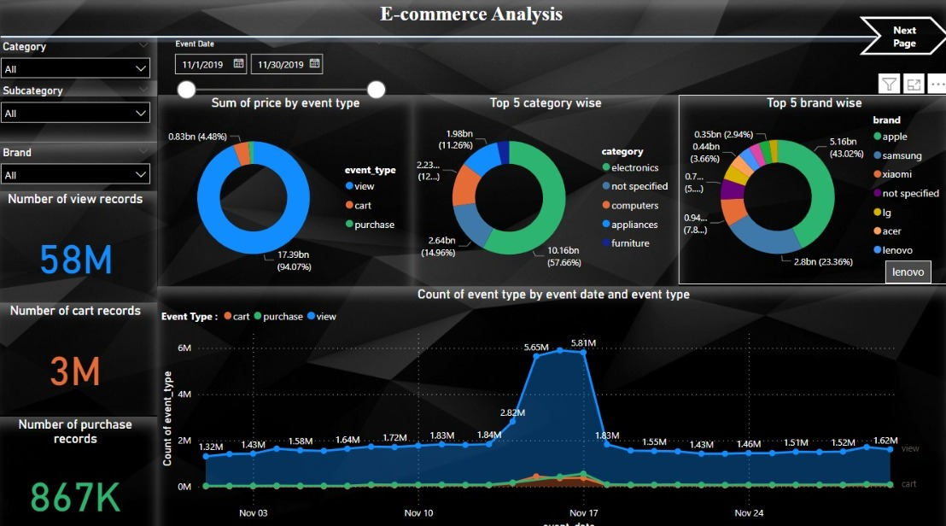

Slide 9
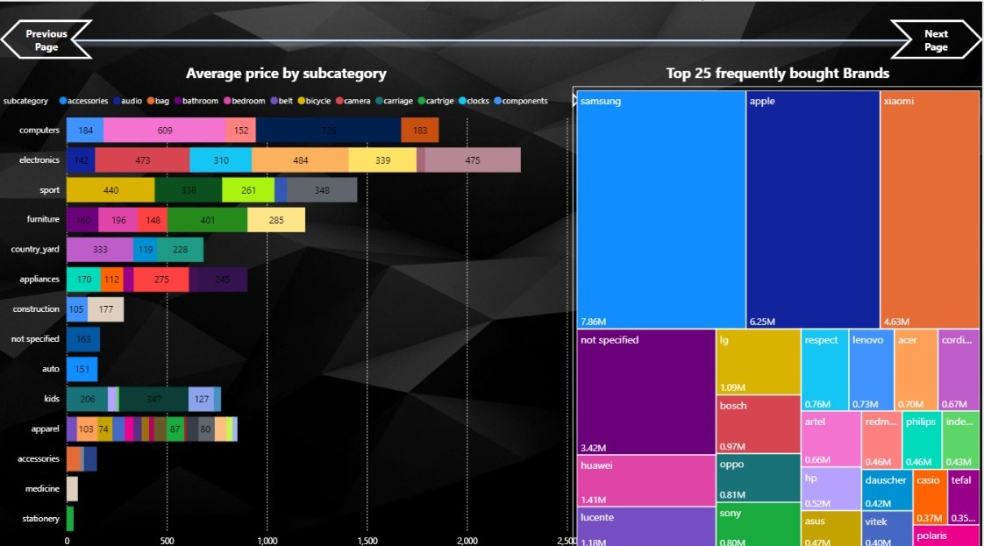

Slide 10
Thank You!

